Slide 1
Short-Text Topic Modeling via Non-negative Matrix Factorization Enriched with Local Word-Context Correlation
Reference to the paper:
Tian Shi, Kyeongpil Kang, Jaegul Choo, and Chandan K. Reddy. 2018. Short-Text Topic Modeling via Non-negative Matrix Factorization Enriched with Local Word-Context Correlations. In Proceedings of the 2018 World Wide Web Conference (WWW ’18). International World Wide Web Conferences Steering Committee, Republic and Canton of Geneva, CHE, 1105–1114. DOI:https://doi.org/10.1145/3178876.3186009
Link to the paper:
https://dl.acm.org/doi/pdf/10.1145/3178876.3186009

Slide 2

What is the problem?
Nowadays billions of short texts are generated in social and other media platforms.
Discovering the knowledge or the central theme of the text is leading research.
But the short texts have very low contextual information and sparse.
Hence it is very difficult to learn the topics

Slide 3
What is the proposed method?
To tackle this problem a method called semantics-assisted non-negative matrix factorization(seaNMF) is proposed.
It helps in discovering the topics in short texts.
The seaNMF model is solved using a block coordinate descent algorithm(BCD)
BCD is in contrast to full gradient descent, where a gradient step updates all coordinates simultaneously.

Slide 4
Quantitative and qualitative evaluation
Using the quantitative evaluations over the datasets, the proposed model has good results.
The qualitative semantic analysis demonstrates the interpretability of models.

Slide 5
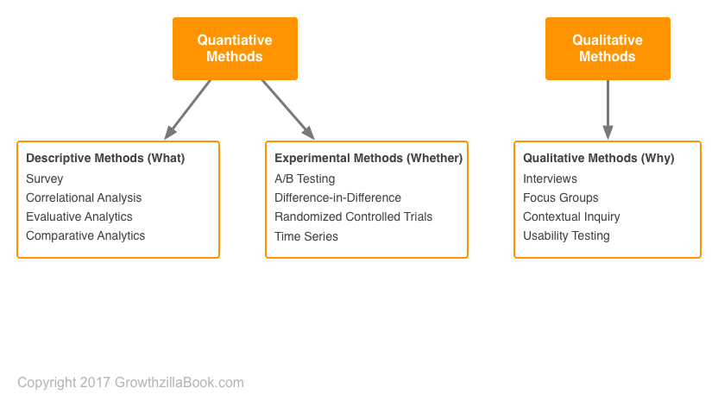
Quantitative VS Qualitative methods

Slide 6
A deeper dive into the problem
A large amount of short texts are being generated through tweets, questions, queries, etc…
Since short texts have very few words it is really challenging to get the topics from the data.
There are two groups of topic models LDA and Non-negative matrix factorization.

Slide 7
NMF model
NMF learns topics by directly decomposing the term document matrix which is a bag-of-words representation.
The NMF based models are performing good in dimension reduction and clustering data.
Though the conventional model achieved good results, these models did not work on short texts.

Slide 8
Related work
To tackle the problems on topic modelling over short texts there are three strategies.
To capture the cross-document word to co-occurrence through aggregation of short texts to pseudo documents.
To consider the word semantic information from external corpus like wiki or google news.
To directly make use of word co-occurrence patterns in documents (ie) short texts.

Slide 9
Problems in NMF for topic modelling
Since the short texts are sparse it leads to poor performance.
To tackle this problem, it is investigated that the algorithms for estimating the factor matrices in NMF.
The relationship between keywords strongly depends on the documents and vice versa.
Since, due to data sparsity, the relationship of keywords are biased.

Slide 10
Problems in Neural word embedding
Word embeddings have demonstrated to be an effective tool in capturing semantics.
Represented by dense vectors, words with similar semantic and syntactic attributes can be found in the same area in the continuous vector space.
One of the most successful method is the skip gram with negative sampling (SGNS).
But it is revealed that the internal relationships between the word and its context, which is critical to overcome the problem of lacking word co-occurrence

Slide 11
The seaNMF model
The semantics assisted NMF (seaNMF) model to learn topics from the short texts.
This model uses the semantic information using the word embeddings enabling the seaNMF to recover word co occurrence.
Thus, solving the drawbacks of NMF and neural word embedding in short texts.

Slide 12
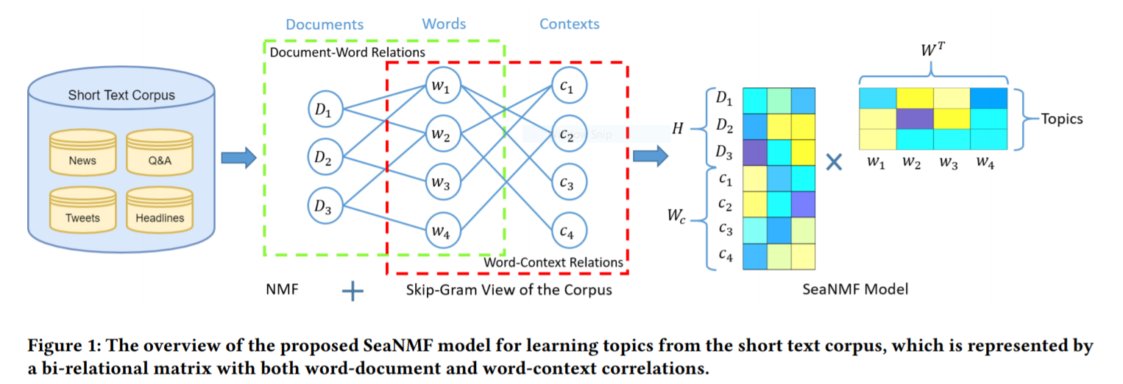
Design of seaNMF model

Slide 13
Model formulation
The challenge is to approximately introduce the word semantics to the NMF.
To reveal the semantic relationship between the keywords and their context, a matrix is defined.
With the word and context representation, we can define a semantic correlation matrix.
There are two remarks, they are,
The semantic correction matrix is not required to be symmetric.
Each short text is viewed as a window.

Slide 14
Computational Complexity
The computational complexity of seaNMF model is same as the NMF model.
The complexity is O((M+N)MK), where N is the no.of documents, M is the no.of distinct words.
But due to data sparsity in short texts this complexity can be further reduced.

Slide 15
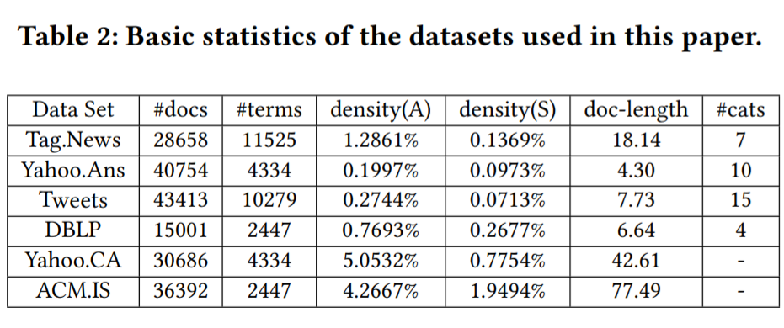
Experimental results
The datasets used for testing the proposed model are,
Tag.News
Yahoo.Ans
Tweets
Google-News
DBLP

Slide 16
Evaluation Metrics
Here topic coherence and document classification accuracy are used for evaluation.
The average PMI score can be used to evaluate the quality of the models.
But the PMI measure will work good on regular documents only.
So, here the PMI score is calculated on 4 short texts as usual.

Slide 17
Document Classification
Here the latent document representations are used for external tasks.
A 5-fold cross validation is used to evaluate the performance of the classification.
Finally the quality of the classification is measured by average, precision, recall and F-score

Slide 18
Comparison methods
The performance of the proposed method is compared with,
LDA
NMF
Pseudo document based topic modelling (PTM)
GPUDMM

Slide 19
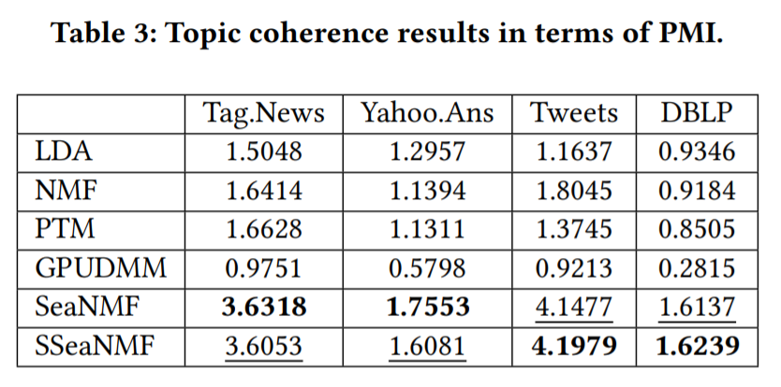
Topic coherence results
The proposed method outperformed the NMF method.
When compared with LDA and PTM, seaNMF showed significant improvements and are more coherent.
The bold font is used to show the best performance values and the underlined to highlight the second best values.

Slide 20
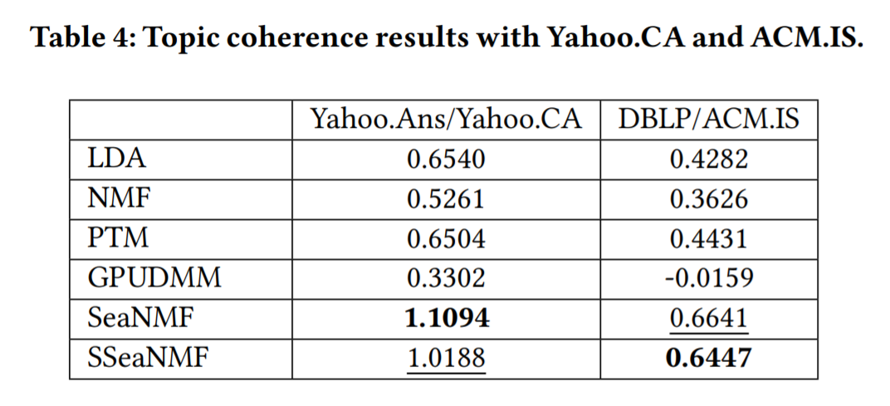
Revaluation
As discussed earlier, the PMI scores are problematic for short texts, they have also evaluated topic coherence score again on different datasets.
It seems seaNMF outperformed other models

Slide 21
Document classification results
In addition to topic coherence the document classification performance of different methods is compared.
In terms of document classification the seaNMF outperforms the standard models.
seaNMF has an average more than 12% improvements over the other baseline methods.

Slide 22
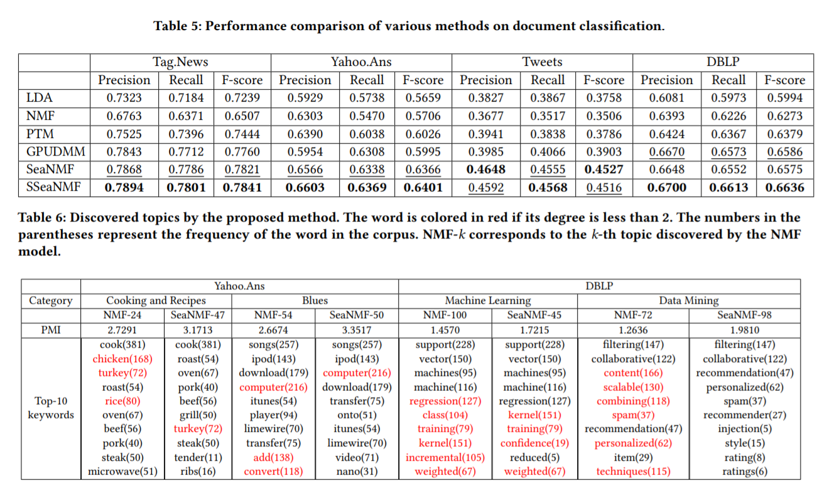
Results of document classification

Slide 23
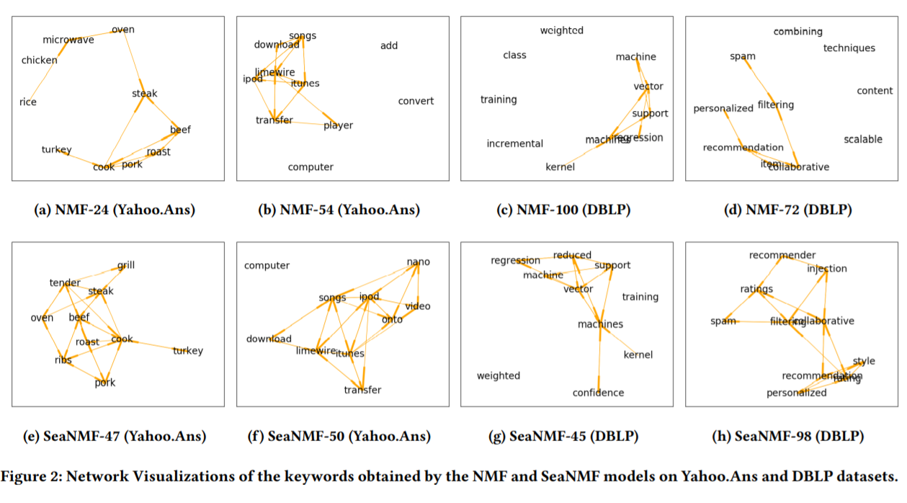
Visualization of seaNMF

Slide 24
Parameter sensitivity
The stability and consistency of seaNMF is controlled by varying ∝, к, ४.
The ∝ is the weight for factoring the word semantic correlation.
The effects of ∝ on the topic coherence and classification accuracy on DBLP is studied.
The topic coherence is increased as the weights are increased.

Slide 25
Conclusion
The proposed model leverages the word-context semantic correlations in the training, which potentially overcomes the problem of lacking context that arises due to the data sparsity.
The quantitative evaluations demonstrate that our models outperform other methods with respect to widely used metrics such as the topic coherence and document classification accuracy.
The parameter sensitivity results demonstrate the stability and consistency of the performance of our SeaNMF model.

Slide 26
Thank you!

